Slide 1
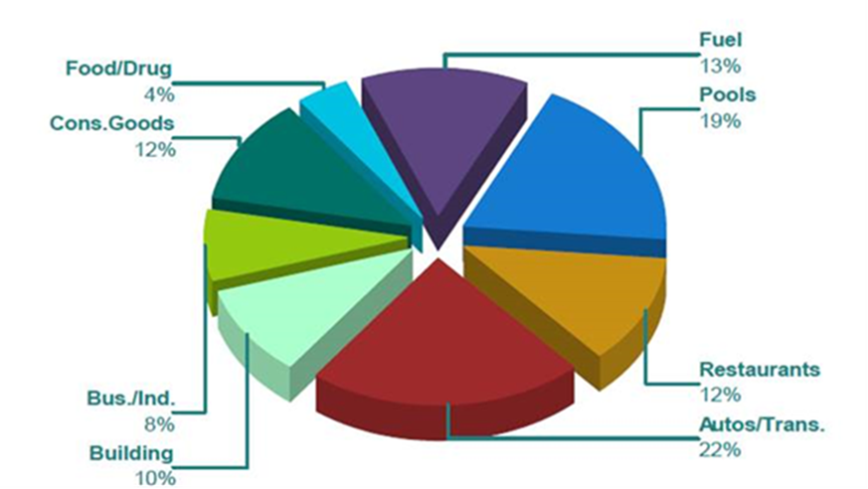
RETAIL
1.3M SF of existing retail
Entitled Retail Centers
  Madrone Village Phase II
  (4.4 acres)
  Cochrane Commons Phase II (135k SF)
  Evergreen Village @ Cochrane (10+ acres)
4% Vacancy Rate
New Retailers Coming Soon!
Sales Tax collections account for 25% of General Fund

Slide 2
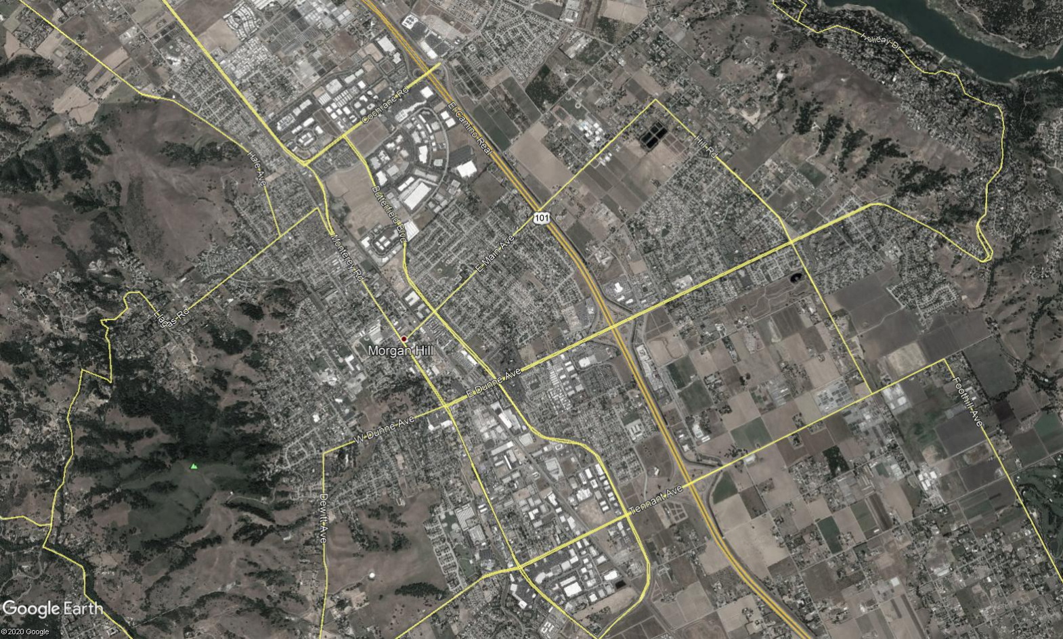
ANNUAL SHOPPING CENTER SALES TAX
$658.4
Cochrane Commons
Madrone Village
Cochrane Plaza
Downtown
NW Dunne
Laurel Oaks
Morgan Hill Plaza
Vineyard Town Center
Tennant Station
$50.8
$422.5
$,000 , Benchmark Year 2021
$539.4
$487.7
$737.3
$199.2
$521.6
$312.1

Slide 3
RETAIL
Challenges
  Share Trade Area with San Jose and Gilroy
  Cost of Greenfield Development
  City population under 50,000
Long-Term Vacancies
  Madrone Village Phase II (4.4 acres)
  +20k sq. ft. @ Cochrane Plaza
  +20 sq. ft. @ Laurel Oaks

Slide 4
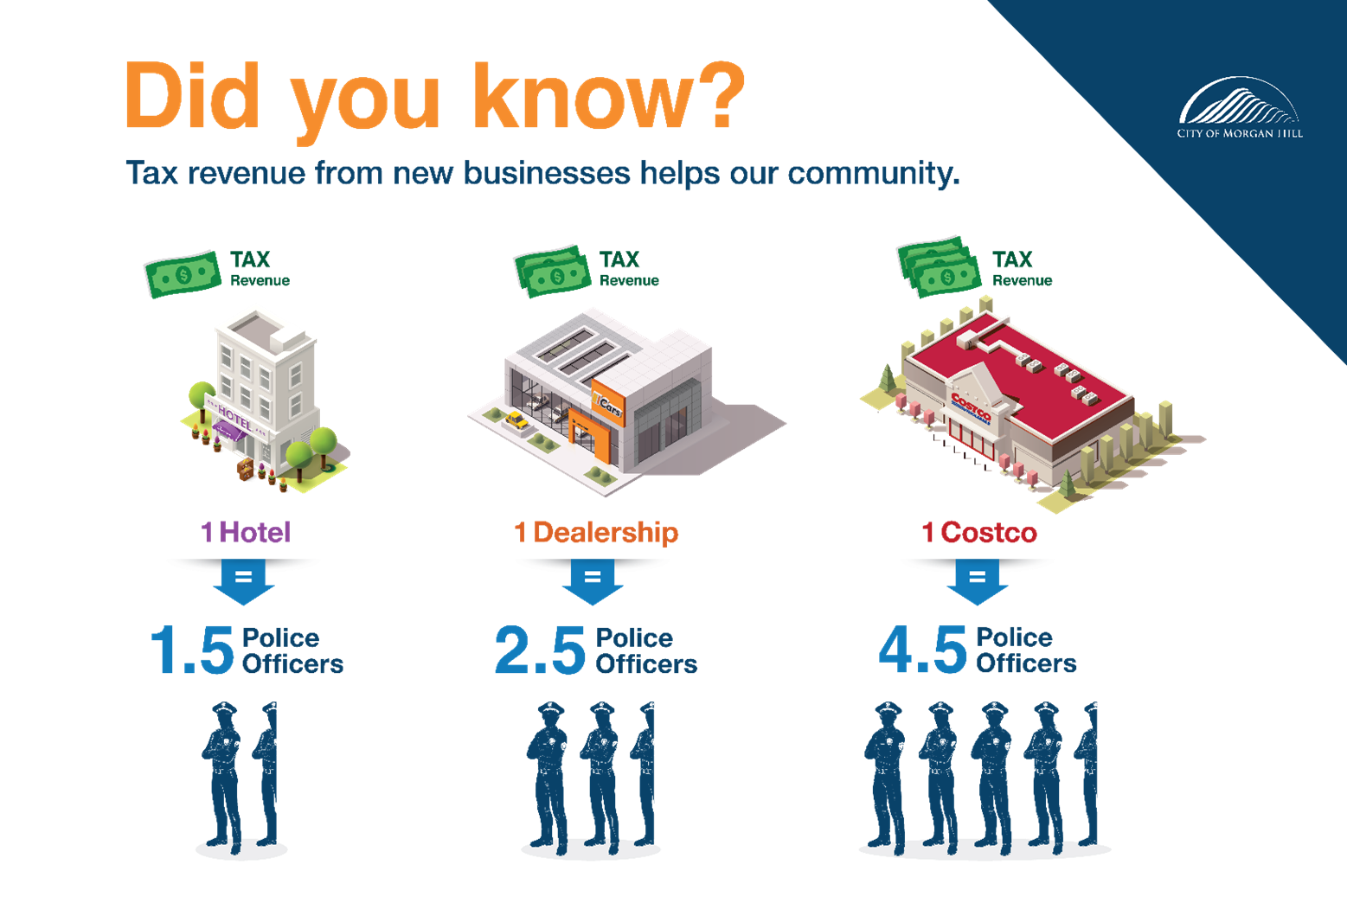
RETAIL IMPACT

Slide 5
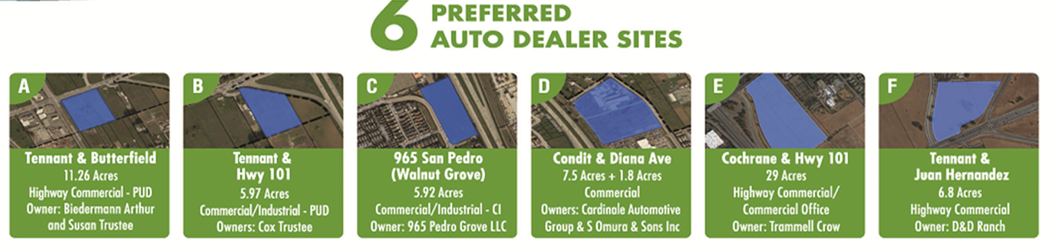
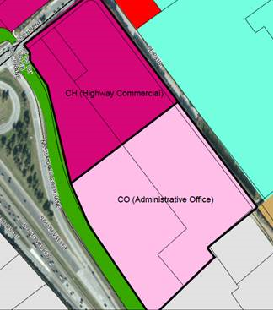
AUTO DEALER SITES
Cochrane & Hwy 101
Significant development interest has been expressed
Create flexibility in the CO Zoning District
Reduces barriers for any future development
Provides certainty
Makes property more attractive to potential investor & developer

Slide 6


TOURISM
Assets:
Agriculture - U-Pick Farms, Hiking/Biking Trails
Wine Trail - 32+ Award Winning Wineries
Regional Sporting Events - Amgen Tour of CA, CrossFit Games, Far West Swim, Soccer
Outdoor Sports Center- tournaments, concerts, special events
Support:
Tourism Business Improvement District (TBID)
Hotel Incentive Policy
Outdoor Sports Center Masterplan
Downtown Development - Boutique Hotel, Edes Art Gallery, PBID

Slide 7
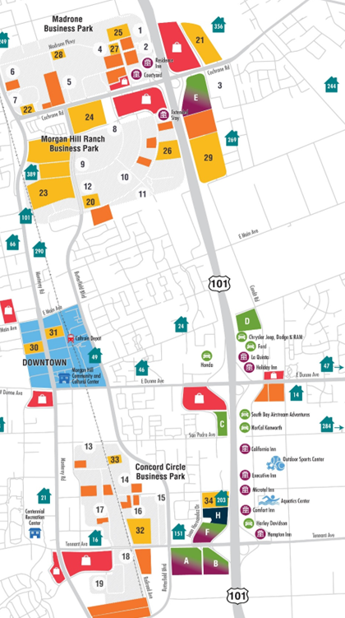
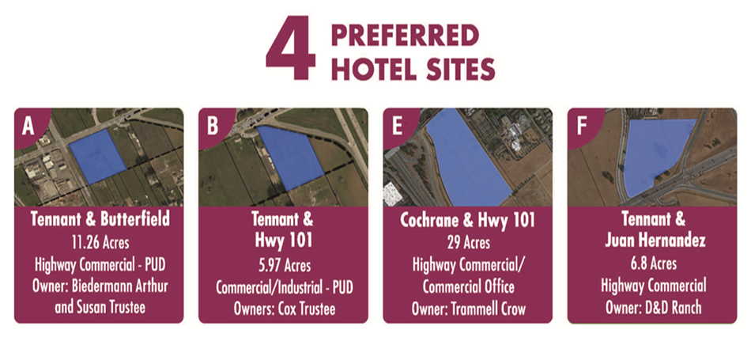
TOURISM

Slide 8
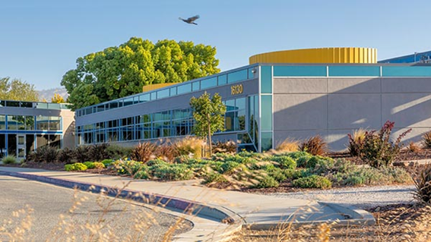
HEALTHCARE
Limited Healthcare Options
DePaul Healthcare Center Under Renovation
Updated Zoning to Allow Medical Uses in Most Zones
Entitled site for Future Healthcare/Medical Center

Slide 9
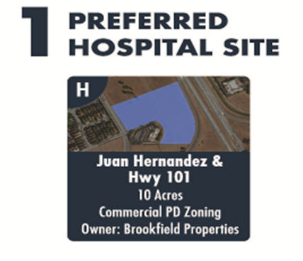
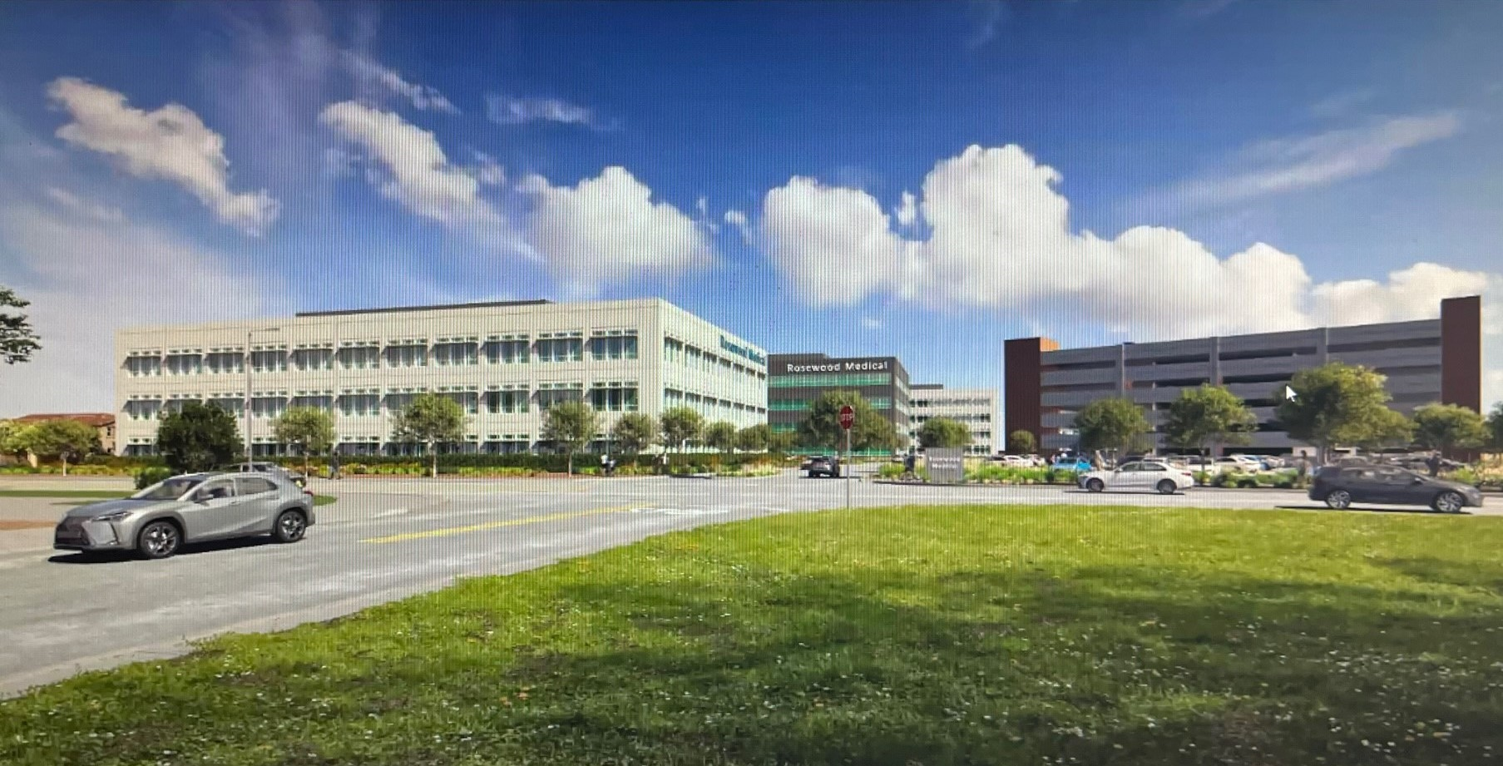
HEALTHCARE
Expanded locations for Medical Uses
Actively promote locations for Medical Uses
Increase outreach to Medical Service providers
Juan Hernandez site is currently pursuing a PD amendment to increase potential project size
Create & Implement a targeted marketing campaign

Slide 10
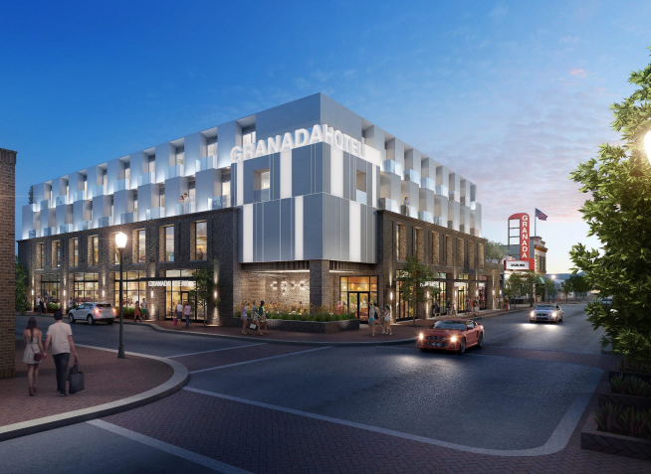
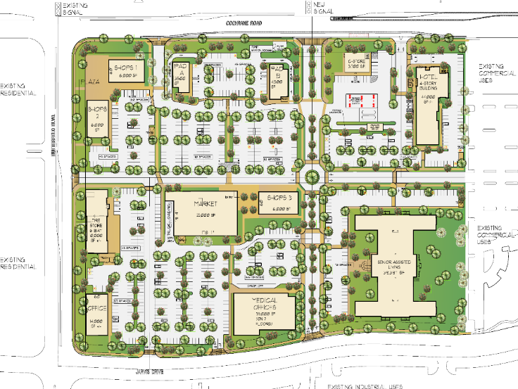
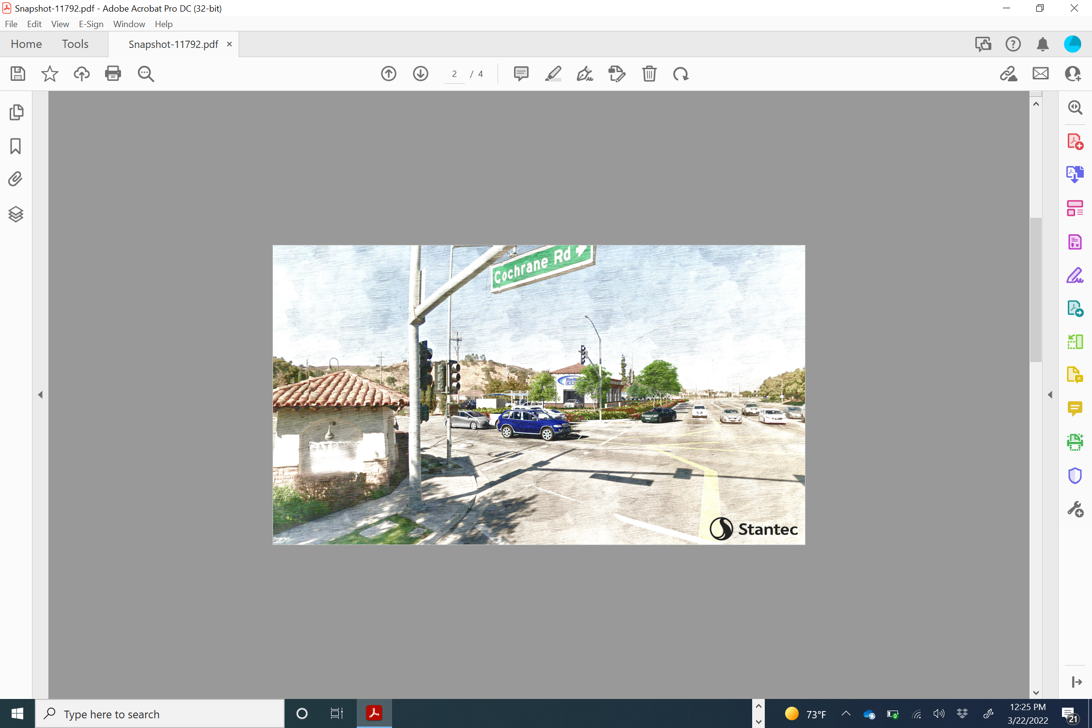
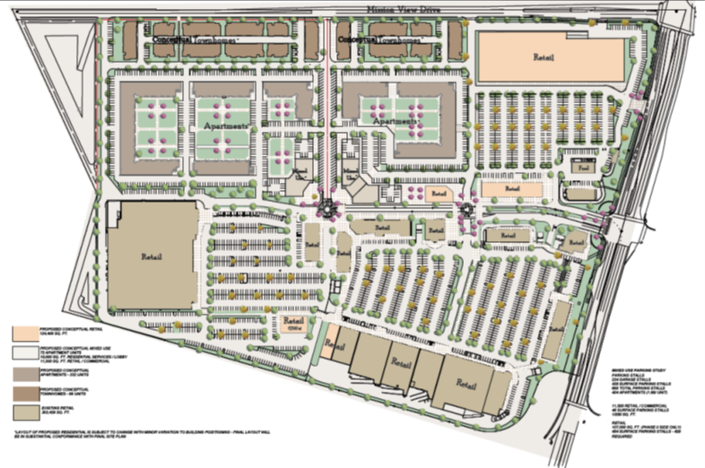
Commercial Projects Underway
Cardinale Automotive
36,000 SF
Edes Gallery
6,600 SF
Hotel MOHI
73 Rooms
Evergreen Village
7/11 Gas, Starbucks, Taco Bell, Holiday Inn Express
Bluewave Carwash
Cochrane Commons Phase II
135,000 SF undeveloped

Slide 11
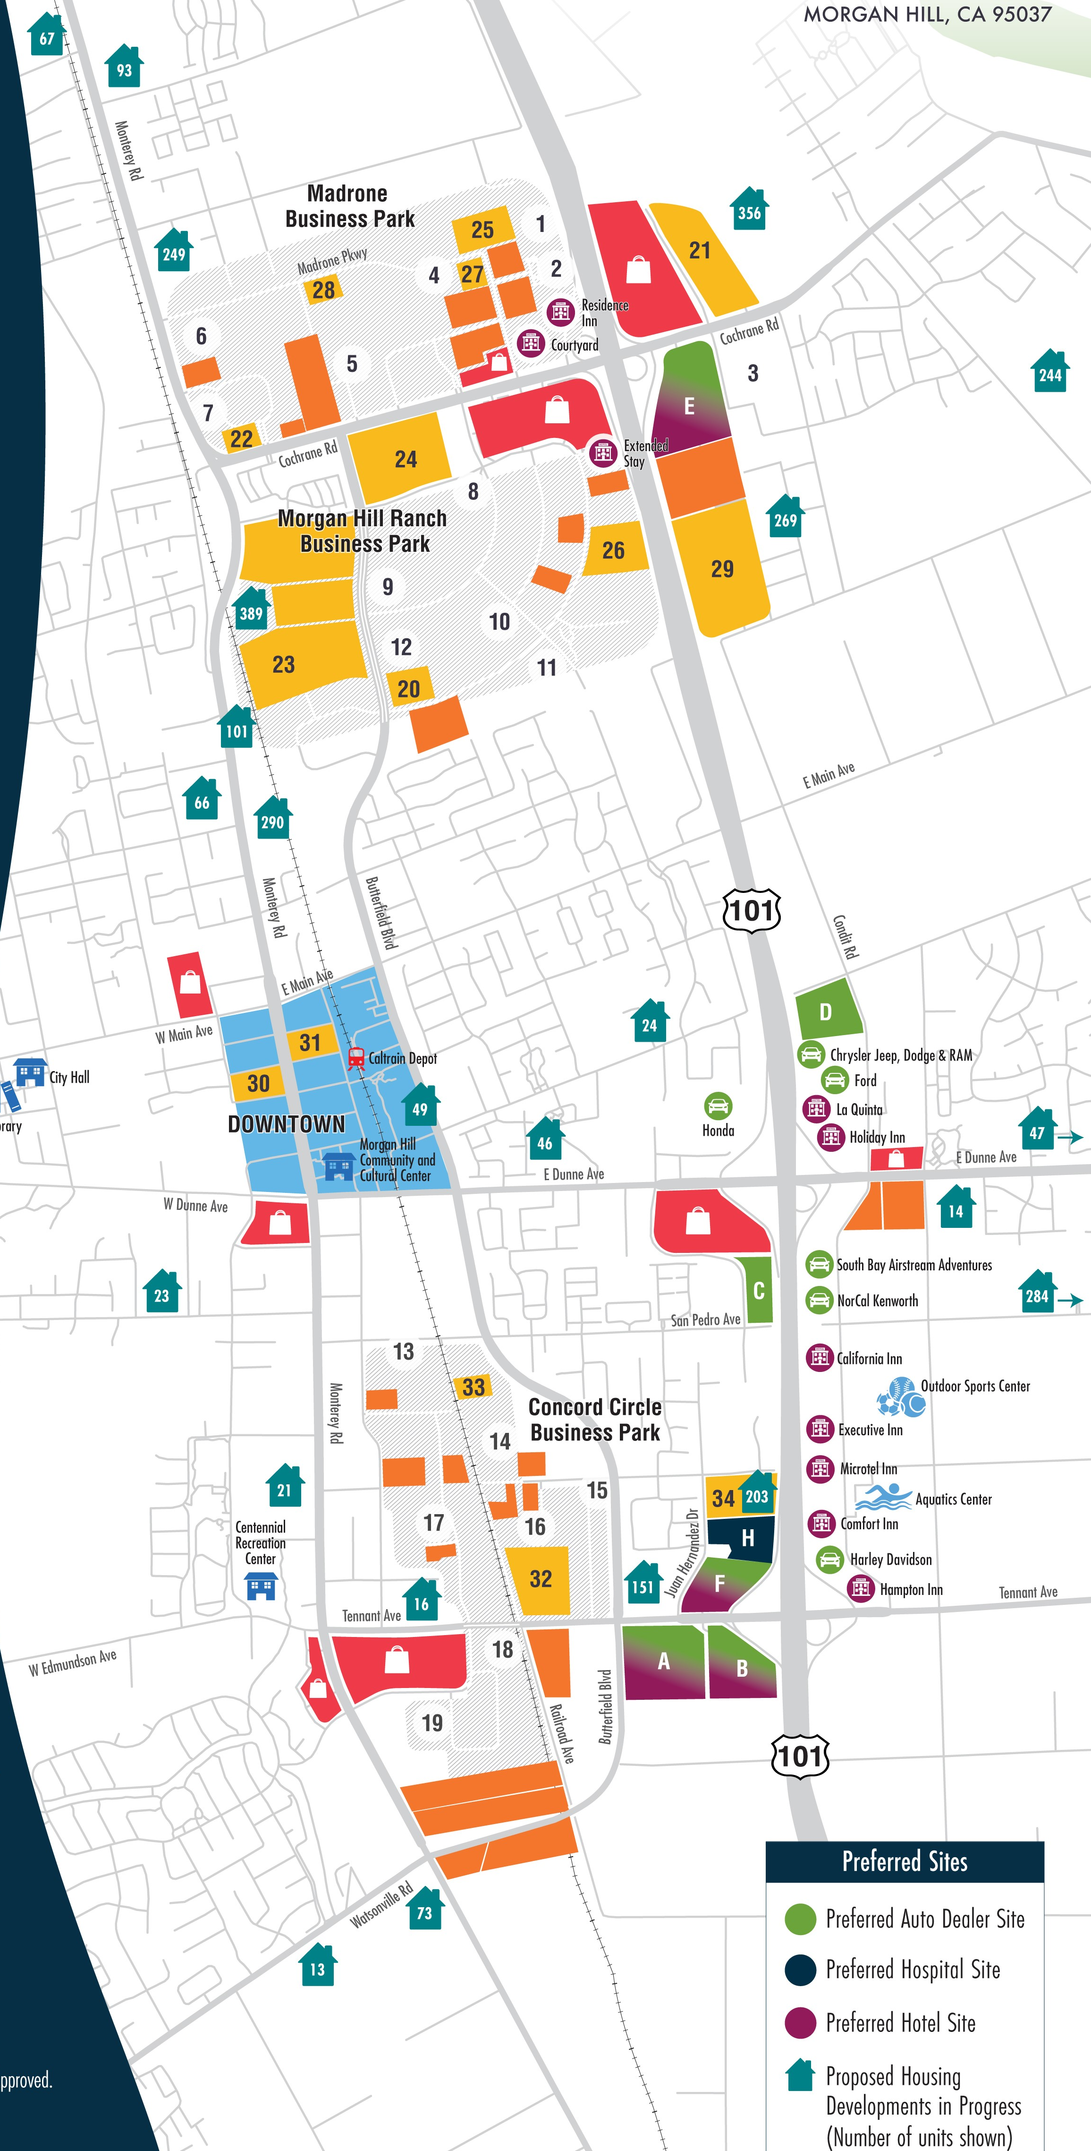
HOUSING
Population growth of 2%
1 of every 8 homes is
income restricted
Largest per capita affordable housing ownership program in the State
One of the few Silicon Valley cities projected to meet RHNA numbers for the current cycle
1% apartment vacancy rate
2,900 housing units in the pipeline currently
2 Farmworker housing projects under development

